Slide 1
Literature Survey on Temporal Graph Stores and Processing Presentation - 1
Shriram R
07-Jun-19

Slide 2
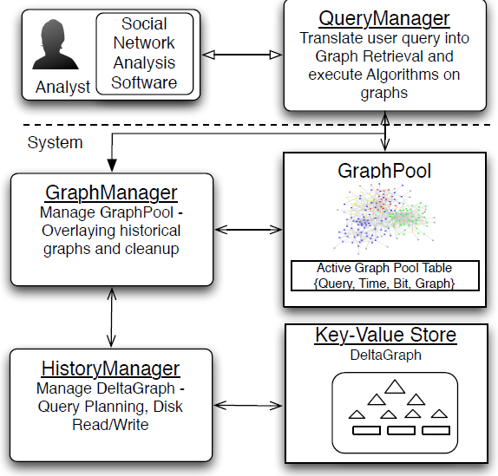
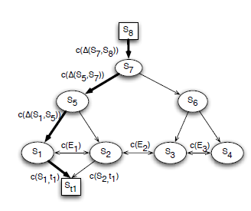
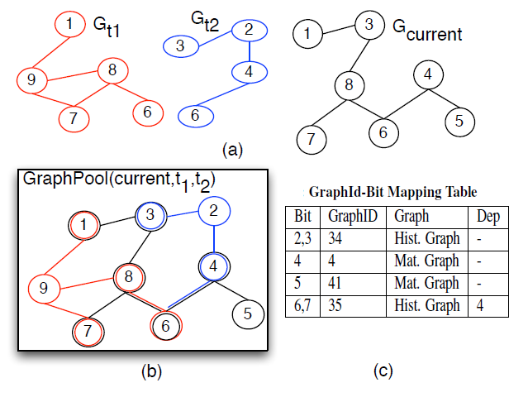
Efficient Snapshot Retrieval over Historical Graph Data [1]
DeltaGraph – Distributed hierarchical index structure
GraphPool – in-memory historical graph data structure

Slide 3
Efficient Snapshot Retrieval over Historical Graph Data [1]
Optimizations
Maintain statistics of deltas and eventlist in memory
Materialize certain nodes in memory
Parameter Tuning – Choosing differential function and arity
Efficient usage of bitmaps for in-memory store
Gaps
Effect of partitioning and need of repartitioning
Behaviour on graphs with different topologies and more real-world graphs
Structural and Property changes are treated alike
Support for queries that retrieve snapshots satisfying a given predicate

Slide 4
Automatic Algorithm Transformation for Efficient Multi-Snapshot Analytics on Temporal Graphs

Slide 5
Related Work
Graph Processing
Pregel [2]
Giraph [3]
GraphX [4]
Trinity [5]
Quegel [13]
Graph Caching
GC [6]
Graph Databases
GoDB [11]
TinkerGraph
Neo4j
Dgraph
Titan
Graph Indexing
C-Tree [7]
Views [8]
FERRARI [9]
GraphS [10]

Slide 6
Key Contributions
Graph Caching
Cache Knowledge graph in Edge layer
Query Partitioning
Partition input graph query into local and remote
Result Generation
Combine results from local and remote server into a correct result
Different Query Types
Vertex, Edge, Path search and reachability
Result Caching
Cache results from remote layer with cache management

Slide 7
References

